Slide 1
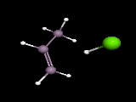

Slide 2
http://www.brunel.ac.uk/depts/chem/ch241s/re_view/addreact.htm
More Simulated Reactions

Slide 3
